Slide 1
More HTML Elements
Module 3

Slide 2
HTML Links
HTML’s links (anchors) are Hyperlinks
Links will allow users to jump to another document, or even another location in the same document
Links can be anything, including images, buttons, or any other element

Slide 3

Link Syntax
Links are created using <a> tags
The href attribute is the location you want to link to
Everything between the start and end tag will be shown to the user
Notes:
HREF – HyperText reference

Slide 4
HTML Links
By default
Unvisited links are underlined and blue
Visited links are underlined and purple
Active links are underlined and red

Slide 5
HTML Links – target Attribute
The target attribute specifies where to open the linked document
It has the following possible values
_self (Default) – Opens document in same tab it was clicked in
_blank – Opens document in a new tab
_parent – Opens the document in the parent frame (used in older version of HTML)
_top – Opens the document in the full body of the window

Slide 6
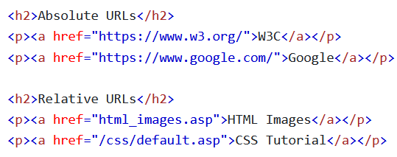
Absolute URLs vs Relative URLs
Absolute URLs – full web addresses
Relative URLs – Link to a page within a website, so it does not need the https://www portion

Slide 7

Images as Links
In most modern websites, images serve as links as well
To do this, put an image element between the start and end tag of the anchor

Slide 8
Link to an Email
Especially when working with address elements, you may want to create a link that will open an email
You can do this by placing mailto: inside of the href attribute but before the email

Slide 9
Buttons as Links
In many websites, links are attached to buttons
For this to work property, you need to write some JavaScript code
We’ll learn more about this in the JavaScript portion of our course

Slide 10
Link Titles
The title attribute specifies extra info for an element
The title attribute can create a tooltip for a link, so that it shows what will happen when you mouse over it

Slide 11
Link Colors

Slide 12

HTML Link Colors
By default, links are blue and underlined when they haven’t been used
We can customize our links colors for each of their states (visited, unvisited, active, hovered)

Slide 13
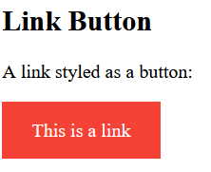
Link Buttons
You can style links to look like buttons using CSS

Slide 14
Link Bookmarks

Slide 15


Creating Bookmarks in HTML
On long web pages, bookmarks can be very helpful
We can create bookmarks by adding anchors that link to ids instead of URLs
Whenever the link is clicked it will jump to the location of the id
This can jump to a point on another page as well

Slide 16
HTML Images

Slide 17
Image Syntax
The <img> element embeds an image in a web page
<img> elements are empty (no content) and have no closing tag
All images have two attributes: src – the path to an image, and alt – Alternate text for an image

Slide 18
The src Attribute
The src attribute specifies the file path (URL) to an image
We need the file path because <img> elements do not actually put an image into the web page, only a reference to one
When it is time to load the page, the <img> element will fetch the image from the web server and display it

Slide 19
The alt Attribute
The alt attribute provides text that describes the image in case it doesn’t load or the user needs a screen reader
The alt text will display if the image cannot be found

Slide 20
Image Size
There are two ways to specify the style of an image:
Use the style attribute to set both the width and height using CSS
Use the width and height attributes

Slide 21
Image Size
You should always specify a width and height of your images to prevent flickering when they display
Either way of sizing an image works, but if you use the style attribute it will prevent external CSS files from changing the size of your images

Slide 22
Animated Images
HTML supports the GIF image format
This allows you to run animations on your page

Slide 23
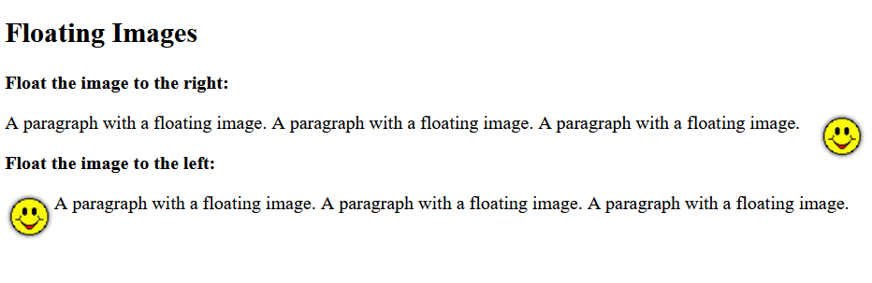
Image Floating
We can use the CSS float property to make an image “float” to the right or left of an element

Slide 24
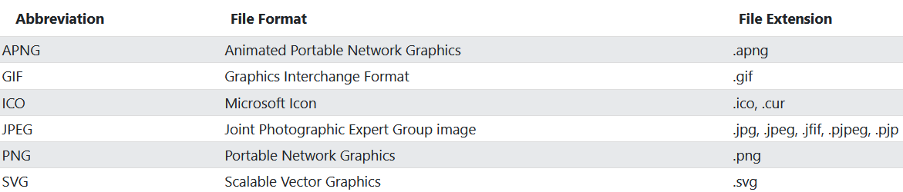
Common Image Formats

Slide 25
Image Maps

Slide 26

Image Maps
Image Maps allow you to create clickable areas on an image
The Image Map is created using the <map> element
The clickable areas are created using the <area> element
Notes:
Try it out on W3Schools

Slide 27
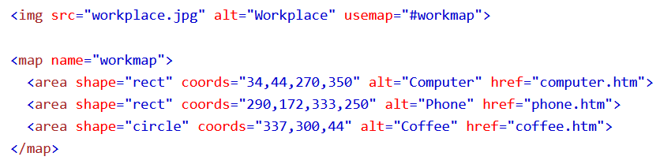
How Does It Work?
The image will work differently depending on where it is clicked
We just need to write HTML code to designate the clickable areas

Slide 28
The Image
To create an image map, we first need to create an image element with the usemap attribute
The usemap value always begins with a # followed by the name of the image map
This will work for any image

Slide 29

Create an Image Map
The <map> element is used to creates the image map using the image you created
<map> has a required attribute of “name”, which is how you link it to the image

Slide 30
The Areas
The clickable areas are <area> elements

Slide 31
Shape
The shape of the clickable area must be defined
You can choose any of the following shapes for the clickable area:
rect – a rectangular area
circle – a circular area
poly – a polygonal area
default – the entire area of the photo

Slide 32
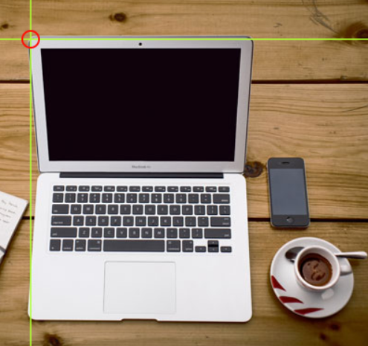
Shape = “rect”
rect’s coordinates come in two pairs
One set of coordinates is x and y axis pixels of the top left corner
The other is the x and y coodinates of the bottom right corner

Slide 33

Shape=“circle”
circle takes a coordinate for the center of the circle and a distance for the radius (distance from center to edge)

Slide 34
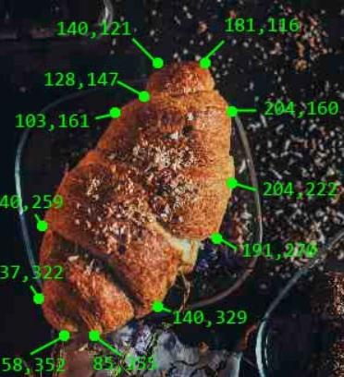
Shape=“poly”
poly can create an image map from as many coordinate pairs as you need
This will allow you to create custom shapes by selecting coordinates on the borders of the area you want to be clickable

Slide 35
Image Maps
The clickable areas we have created can trigger JavaScript functions
These functions can create any effect that we’d like
We’ll learn more about JavaScript in the 3rd section of the course

Slide 36
A Note On Image Maps
Image Maps are a neat feature, but it can be a pain to find the coordinates of an image
Many Image Maps are created using percentages rather than pixels, since images sizes may need to be different sizes for different screens
Additionally, not all browser’s dev tools allow you to see the pixel coordinates of an image, so you may need either image editing software or JavaScript to step in
Notes:
I will provide JavaScript code for any images that you will need to work with

Slide 37
Background Images

Slide 38
Background Image on an HTML Element
Background images allow you to create interesting backgrounds using any image that you choose
You can create background images using the style attribute of an element with the CSS background-image property

Slide 39

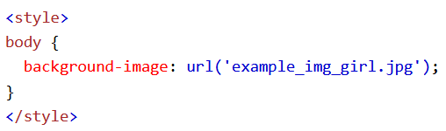
Background Image on a Page
Sometimes you’ll want a background image to cover an entire page
You can accomplish this by setting the background-image property of the body element
Be default the image will repeat itself (horizontally and vertically) if it is smaller than the element it is inside of

Slide 40
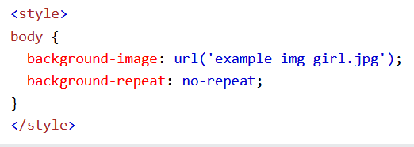
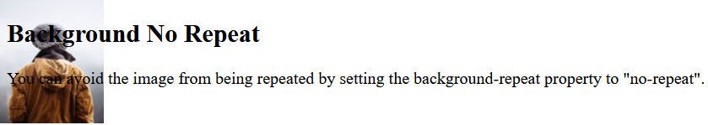
Background Repeat
This generally isn’t what you’re looking for, so you can stop this by using the CSS background-repeat property to no-repeat
This will display the image in its current size a single time inside your body element

Slide 41
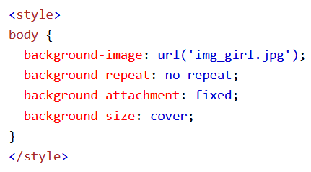
Background Cover
If you want an image to cover an entire element (like body), you can set the CSS background-size property to cover
You will also want to set the CSS background-attachment property to fixed

Slide 42
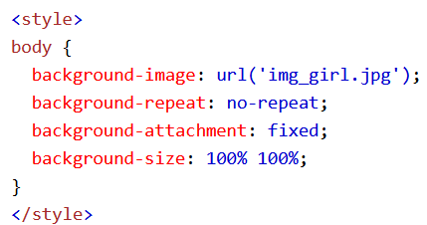
Background Stretch
If you want the background image to fit the entire element, you can set the CSS background-size property to 100% 100%

Slide 43
The Picture Element

Slide 44
The HTML <picture> Element
The <picture> element gives web developers more flexibility in specifying image resources
<picture> elements can contain multiple <source> elements, each of which refers to a different image
This will let you display different images (with different resolutions) depending on screen size

Slide 45
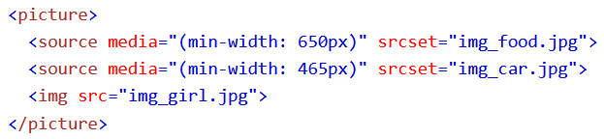
The HTML <picture> Element
Each <source> element has a media attribute defines when the image is most suitable
The last element of a <picture> element should always be an <img>, since some browsers do not support <picture>

Slide 46
When to Use <picture>
Bandwidth
Smaller devices like phones won’t benefit from loading large, high resolution (>2k) images, so we can save on performance
Format Support
Certain browsers may not support some image formats, so the browser will use the first format it does recognize

Slide 47
HTML Tables

Slide 48
Define a Table
The <table> tag creates an HTML table
You can create table rows with the <tr> element
You can create table headers with the <th> element

Slide 49
Define a Table
Every cell of the table is defined using a <td> element
Can hold almost any element
<th> elements are bold and centered by default
<td> elements are regular and left-aligned by default

Slide 50
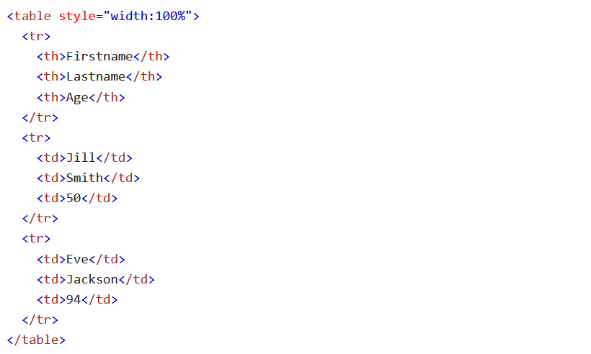
Table Examples

Slide 51
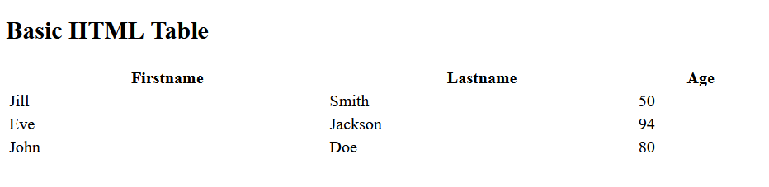
Table Examples

Slide 52

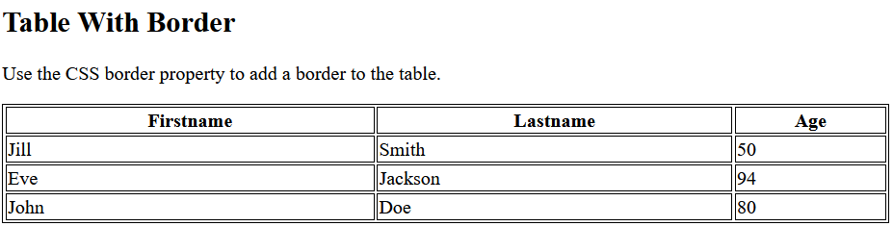
Adding Borders
To create borders for your table, use the CSS border property

Slide 53
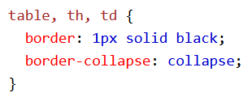
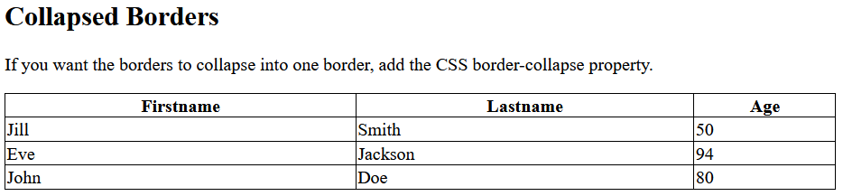
Collapsed Border
Having a borders for every individual cell looks pretty ugly, so we can use the CSS border-collapse property to make it so that cells will share a border instead

Slide 54
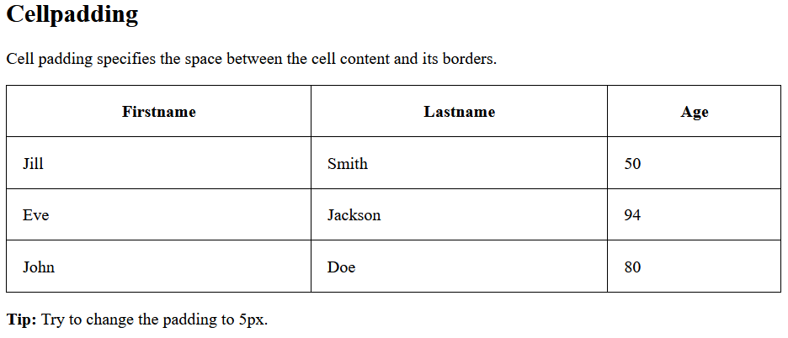

Add Cell Padding
Just like with most elements, the CSS padding property is the space between the content and the border of the element
<td> elements have no padding by default

Slide 55

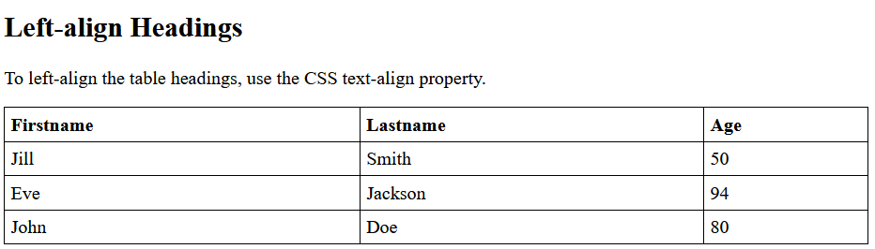
Heading Alignment
We can change the alignment of a heading using the CSS text-align property
Most tables align headings on the left side

Slide 56
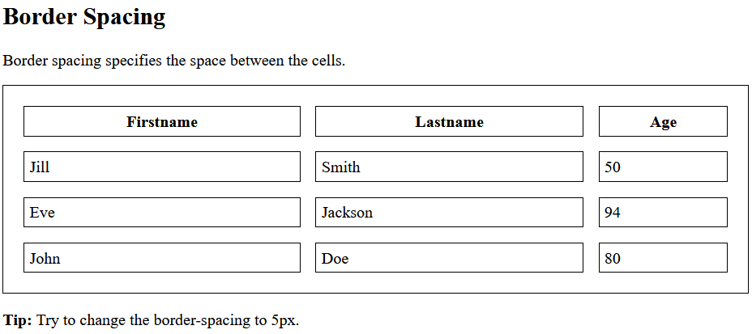

Border Spacing
If you would like, you can add space between the borders of cells using the CSS border-spacing property
If you have the collapsed-borders property set to collapse this will do nothing

Slide 57
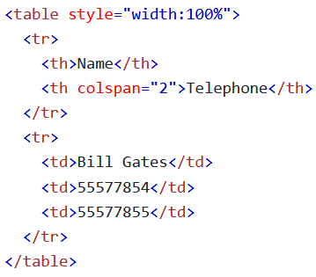
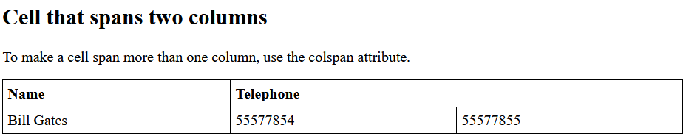
Multi Column Cells
Sometimes your table might need to have multiple <td> elements per heading
To make cells take up multiple columns use the colspan attribute

Slide 58
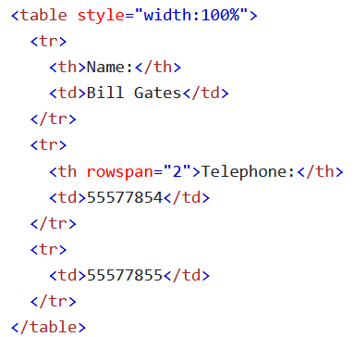
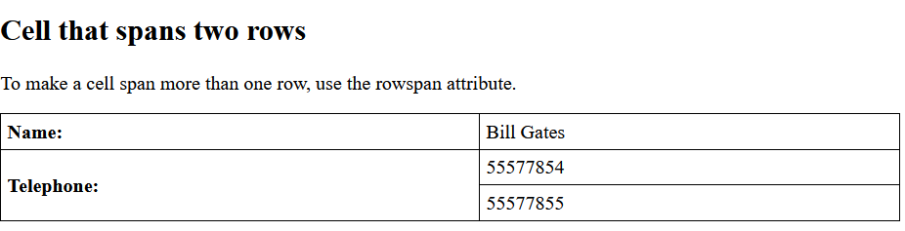
Multi Row Cells
To make a cell span more than one row, use the rowspan attribute

Slide 59
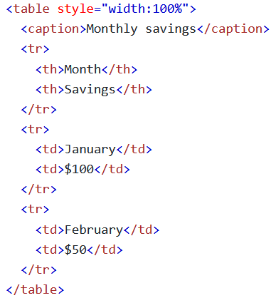
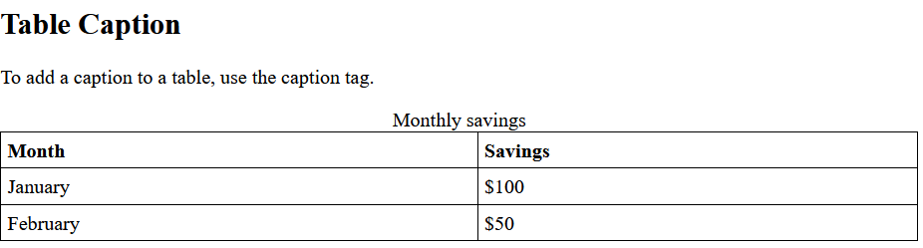
Captions
The <caption> element adds a caption to the table
The <caption> must be on the next line after the <table> element

Slide 60
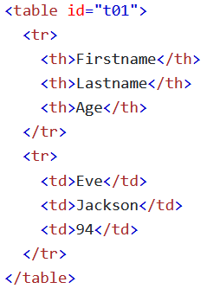
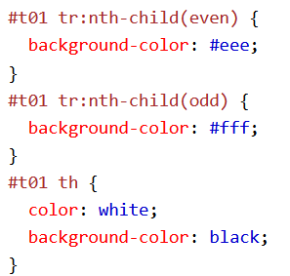
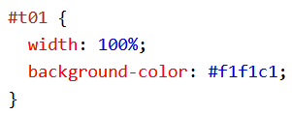
IDs
If a table, or any other element, needs a special style that should only apply to it, you can style it by its id
IDs will allow you to refer to a specific element in both CSS and JavaScript

Slide 61
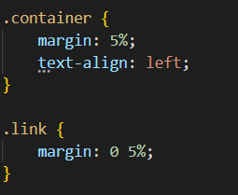
Classes
If multiple elements need the same styling, you can use a class to apply that style to multiple elements at the same time
Classes will allow you to refer to a specific element in both CSS and JavaScript

Slide 62
HTML Lists

Slide 63
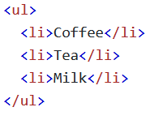
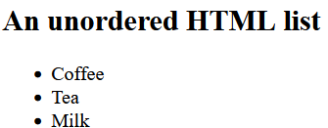
Unordered Lists
An unordered list is a list that uses bullet points (of some sort)
You can create an unordered list using the <ul> element
Its bullet points are list items, created using <li> elements

Slide 64
Ordered Lists
Ordered lists use Numbers instead of Bullet Points
You can create Ordered Lists using the <ol> element
The numbers are also list items, created using the <li> element

Slide 65
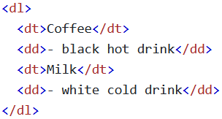
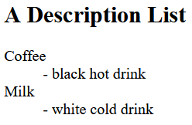
Description Lists
Description Lists are lists of terms with descriptions of each term
Description Lists are created using the <dl> element
Description Terms are created using the <dt> element
Term Descriptions are created using the <dd> element

Slide 66
Unordered Lists

Slide 67
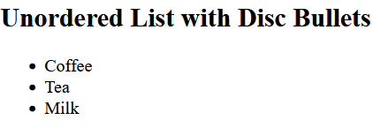
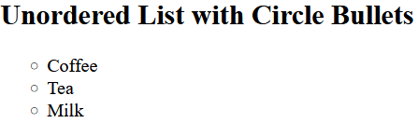
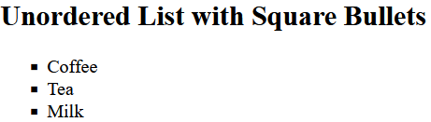
List Item Marker
There are different possible list item markers, like discs, circles, squares, or no markers at all
You can determine which you want to use with the CSS list-style-type property

Slide 68
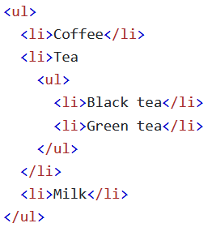
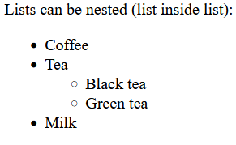
Nested Lists
You can create more detailed lists by placing a list inside of another list
You can do this by placing a <ul> element inside of a <li> element

Slide 69
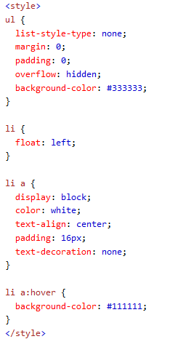
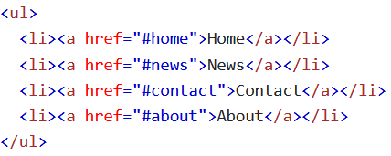

Horizontal Lists
We can style our list items to display side by side instead of one on top of another
This is one way you can create a navbar

Slide 70
Ordered Lists

Slide 71
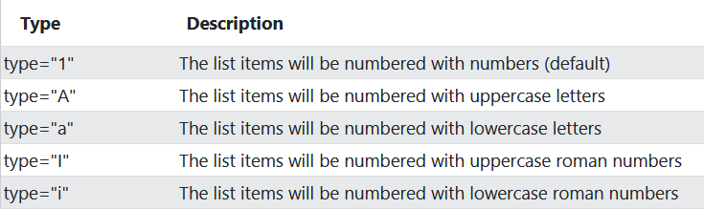
The type Attribute
By default ordered lists will display with numbers, but we might want to change that
The type attribute of the <ol> element allows us to specify which one we want to use

Slide 72





The type Attribute Examples

Slide 73
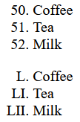
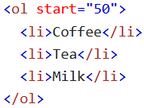
The start Attribute
If you want to start counting from a specific number you can use the start attribute
This will allow you to start counting from a number other than 1

Slide 74
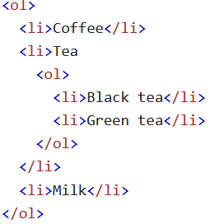
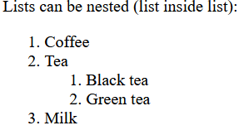
Nested Lists
Just like with Unordered Lists, Ordered Lists can nest lists inside of each other as well
You can change the type attribute of the inner list for clarity (and to look more like an MS word-style list)

Slide 75
Block and Inline Elements

Slide 76
Block Level Elements
All elements have a default display value
The most common default values are block and inline
Block-level elements always start on a new line and take up the full width available

Slide 77
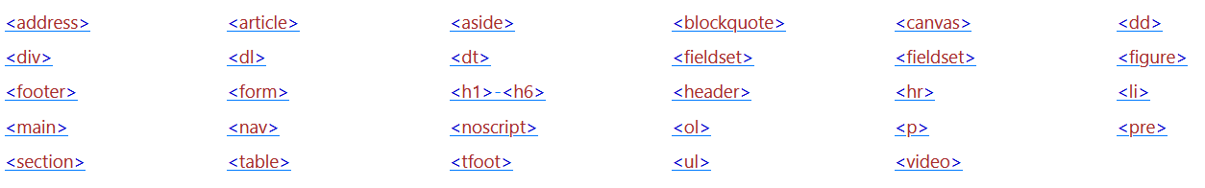
Block Level Elements
Most of the elements we display information with are displayed as block

Slide 78
Inline Elements
Inline elements do not get their own line and only take up as much space as they need, rather than the entire line
Examples: <span>, <b>, <i>, <q>

Slide 79
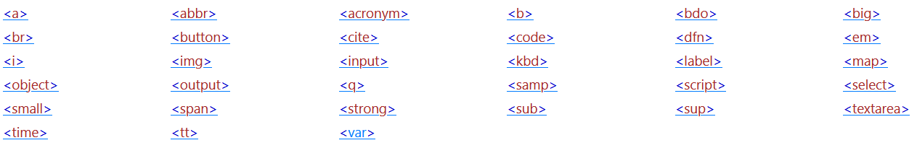
Inline Elements
Inline elements cannot contain block level elements (<b><p>Hi</p></b>)
Here is a list of many of the inline elements we have encountered already or will encounter

Slide 80
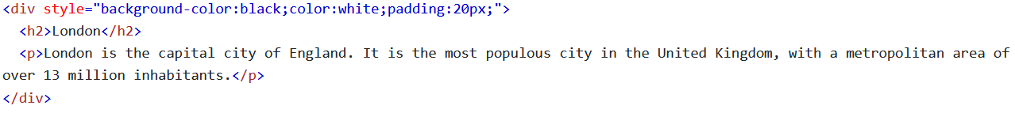
The <div> Element
<div> elements are among the most important elements
It is used as a container to organize other elements
<div> elements do not have required attributes, but are almost always used with id and class

Slide 81

The <div> Element
<div> elements can be styled
When they are styled, their children (the elements inside of them) will be inherit the style of the <div>

Slide 82

The <span> Element
A <span> element is an inline container that is often used to markup or style a part of a document
Just like with <div>s, there are no required attributes but it is common to use class and id
When used with CSS, <span> elements can style part of a piece of text

